Slide 1

Vel Tech Rangarajan Dr. Sagunthala R&D Institute of Science and Technology
School of Computing
Department of Computer Science and Engineering
10211CS224 / FULL STACK APPLICATION DEVELOPMENT (JAVA)
PROJECT REVIEW : MILESTONE PROJECT – 1
Date: 25-03-2026
Relational Inventory Control & Stock Tracking System
SDG: SDG 9 – Industry, Innovation and Infrastructure
Presented By:
A Harshith Reddy– VTU24669 – 23UECS0655
Courses Handling Faculty:
Dr. Hafizur Rahman

Slide 2
INTRODUCTION
Many businesses still manage inventory manually using paper or basic tools.
Manual methods are slow and can lead to mistakes and data loss.
It becomes difficult to track stock levels and product details accurately.
This project is important because it provides an easy and automated solution.
It helps save time and reduces human errors in managing inventory.
The system is useful in real-world places like shops, warehouses, and companies.
It allows users to store, update, and manage product information efficiently.
Overall, it is a simple system that improves inventory control and stock tracking.
1
2
3
4
5
6
7
8
9

Slide 3
PROBLEM STATEMENT
1
Many businesses still use manual methods to manage inventory.
This process is time-consuming and not efficient.
There are high chances of human errors in data entry.
It is difficult to track stock levels in real-time.
Sometimes products go out of stock without proper notice.
Data may be lost or not updated correctly.
There is no proper system to generate reports and analysis.
Hence, there is a need for a simple, reliable, and automated inventory system.
2
3
4
5
6
7
8
9

Slide 4
OBJECTIVE(S)
To design and develop a simple Relational Inventory Control & Stock Tracking System.
To implement an automated system to manage products and track stock efficiently.
To improve accuracy and reduce errors in inventory management.
1
2
3
4
5
6
7
8
9

Slide 5
PROPOSED SYSTEM
The system provides a digital platform to manage inventory easily.
Users can add, update, and delete product details.
Stock levels are updated automatically in real-time.
All data is stored safely in a relational database.
It reduces manual work and minimizes human errors.
Users can quickly search and view product information.
The system can generate simple reports for better decisions.
It is faster, more accurate, and more efficient than manual systems.
1
2
3
4
5
6
7
8
9

Slide 6
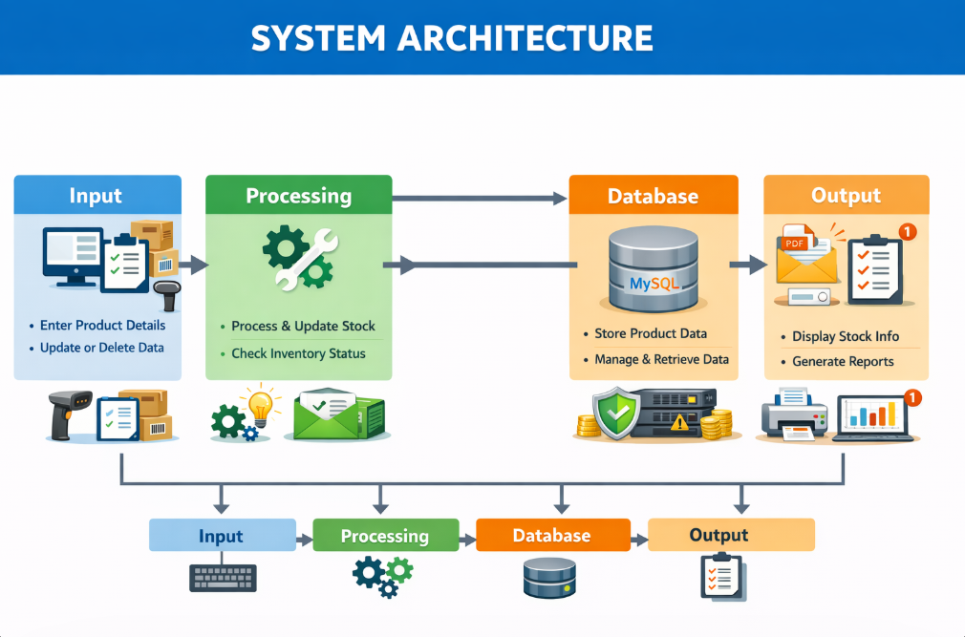
PROPOSED SYSTEM ARCHITECTURE
Input:​ User enters product details like product name, ID, price, and quantity.​ User can also update or delete product information.​
Processing:​ The system processes the user input and performs required operations.​ It updates stock levels and checks for low or out-of-stock items.​
Database:​ All product and stock data is stored in a MySQL database.​ The database helps in easy storage, retrieval, and management of data.​
Output:​ The system displays updated product details and stock information.​ It also generates reports showing available, low, and out-of-stock items.​
​
1
2
3
4
5
6
7
8
9

Slide 7
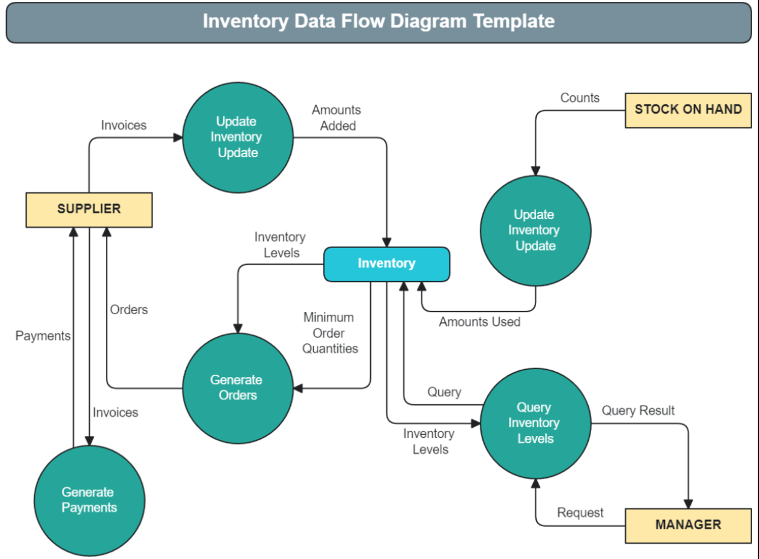
WORKFLOW
Supplier sends invoices to the system.
Update Inventory adds the new stock to the Inventory store.
Stock on Hand counts are sent to update the system.
Amounts used are deducted from the Inventory store.
Inventory levels are checked to see if stock is low.
Generate Orders automatically places an order with the Supplier if stock is low.
Generate Payments sends payment back to the Supplier.
Manager can query inventory and get results anytime.
1
2
3
4
5
6
7
8
9

Slide 8
TECHNOLOGIES USED
Frontend:
HTML and CSS are used to design the user interface.
They help create simple, clean, and user-friendly screens for the system.
Backend:
Java is used to handle the main logic of the application.
It processes user inputs, performs operations, and connects with the database.
Database:
MySQL is used to store all product and stock details.
It helps in organizing data in tables and retrieving it quickly when needed.
Tools:
Eclipse is used for coding and development.
MySQL Workbench is used to manage the database easily.
Hardware/Software Requirements:
A computer or laptop with minimum 4GB RAM is required.
Operating system like Windows or Linux is needed.
Java JDK must be installed to run the program.
A web browser like Chrome is used to access the system.
1
2
3
4
5
6
7
8
9

Slide 9
MODULE DESCRIPTION
Module 1: User Management
Handles user login and authentication.
Ensures secure access to the system.
Different users can access based on roles (if added).
Module 2: Product Management
Allows adding, updating, and deleting product details.
Stores product name, ID, price, and category.
Helps in organizing all items properly.
Module 3: Stock Management
Keeps track of available stock quantity.
Updates stock automatically when items are added or sold.
Prevents out-of-stock situations by monitoring levels.
Module 4: Report Generation
Generates reports of stock, sales, and product details.
Helps in analyzing inventory performance.
Supports better decision-making for business.
1
2
3
4
5
6
7
8
9

Slide 10
IMPLEMENTATION SCREENSHOTS
Home Page
The home page shows the main options of the system like products, stock, and reports.
It provides easy navigation for users to access different features.
Login Page
The login page allows users to enter username and password.
It ensures only authorized users can access the system.
Main Module
The main module displays product details and stock information.
Users can add, update, or delete products from this page.
Output Page
The output page shows the final results like stock status and reports.
It helps users view updated inventory details clearly.
http://localhost:8080.
http://192.168.29.222:8080
1
2
3
4
5
6
7
8
9

Slide 11
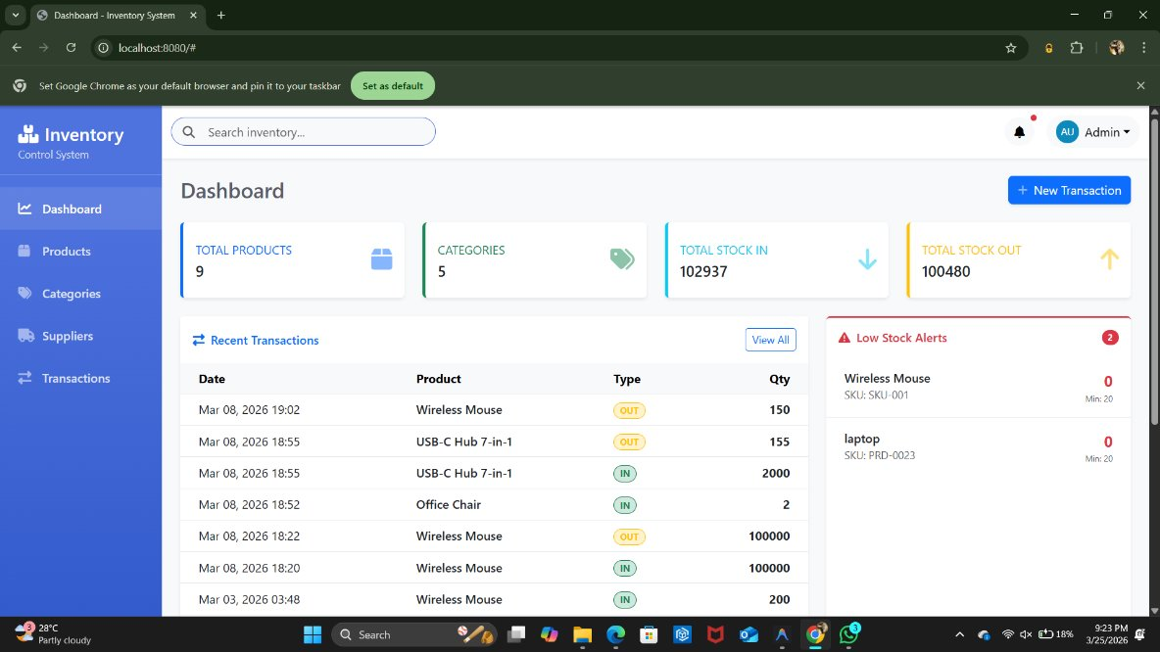
IMPLEMENTATION SCREENSHOTS
This is an inventory dashboard that shows total products, categories, and stock movement.
It also lists recent transactions and highlights items that are low in stock so you can restock them quickly.
1
2
3
4
5
6
7
8(A)
9

Slide 12
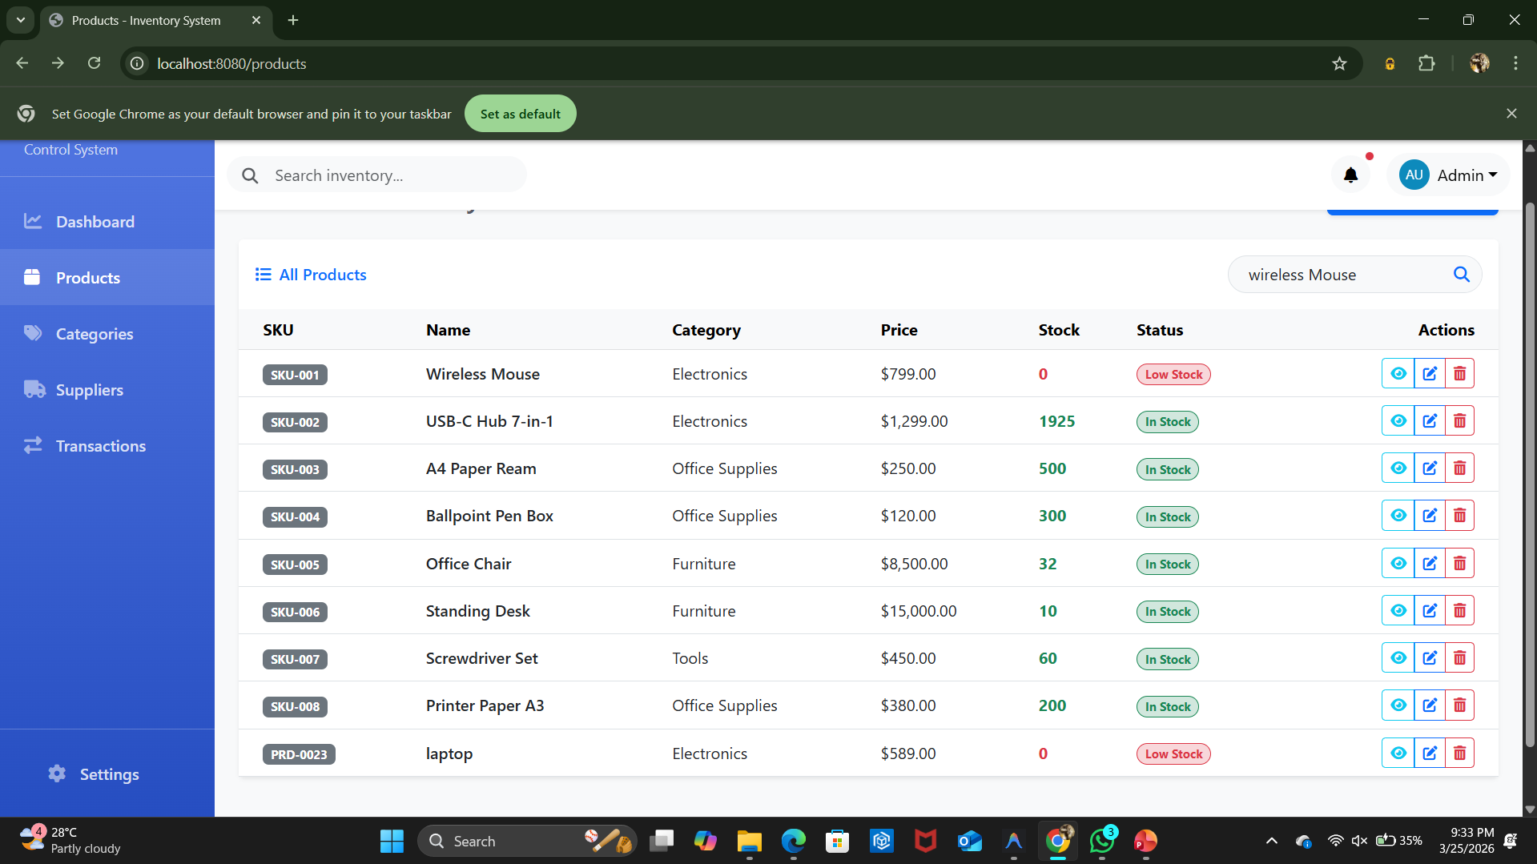
IMPLEMENTATION SCREENSHOTS
1
This page shows a list of product categories with their names, descriptions, and options to edit or delete them.
2
3
4
5
6
7
8(B)
9

Slide 13
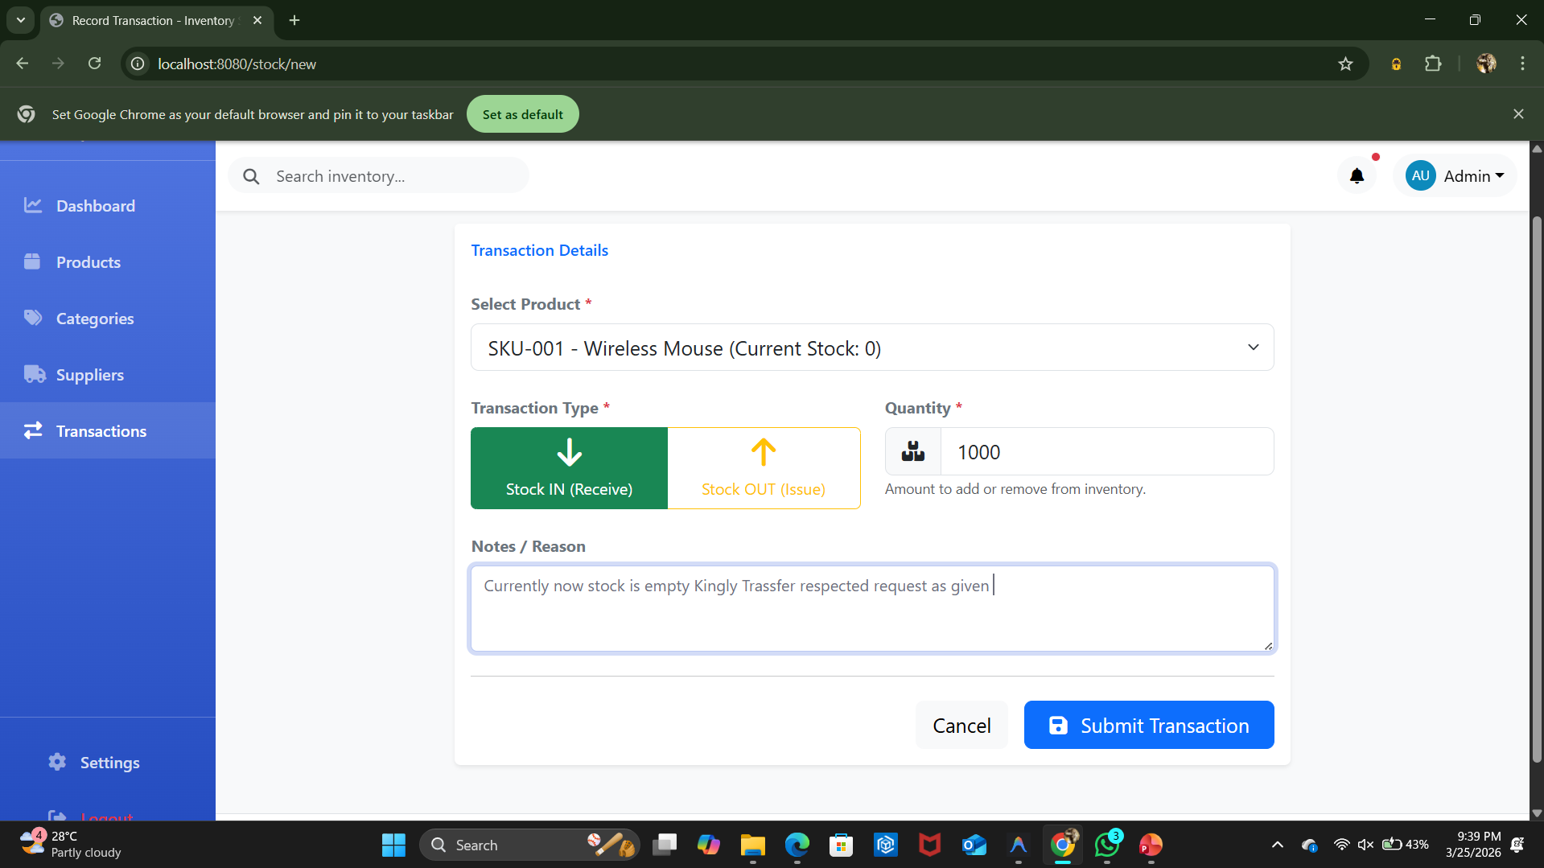
IMPLEMENTATION SCREENSHOTS
1
This page shows all products with their details like price, stock status, and options to view, edit, or delete them.
2
3
4
5
6
7
8(C)
9

Slide 14
ADVANTAGES & LIMITATIONS
ADVANTAGES
Saves time by automating inventory management
Reduces human errors in data entry
Provides accurate and real-time stock updates
Easy to store and retrieve product information
Improves overall efficiency of the system
Helps in better decision-making using reports
LIMITATIONS
Requires a computer system to operate
Needs basic technical knowledge to use
Initial setup may take some time
Limited features in basic version
Requires regular maintenance and updates
Depends on system performance and database
1
2
3
4
5
6
7
8
9

Slide 15
Thank you

